Slide 1
FIT1045 Introduction to Algorithms and Programming Lecture 5 Introduction to Data Structures
COMMONWEALTH OF AUSTRALIA
Copyright Regulations 1969
WARNING
This material has been reproduced and communicated to you by or on behalf of Monash University pursuant to Part VB of the Copyright Act 1968 (the Act).The material in this communication may be subject to copyright under the Act.Any further reproduction or communication of this material by you may be the subject of copyright protection under the Act.
Do not remove this notice.

Slide 2
Objectives
To introduce to lists in Python
To introduce lists of lists in Python.
To introduce graphs
To explain Prim’s algorithm

Slide 3
Overview
Lists
Age of Kids
Tables
Creating Mazes
Prim’s Algorithm

Slide 4
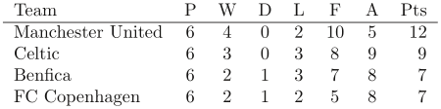

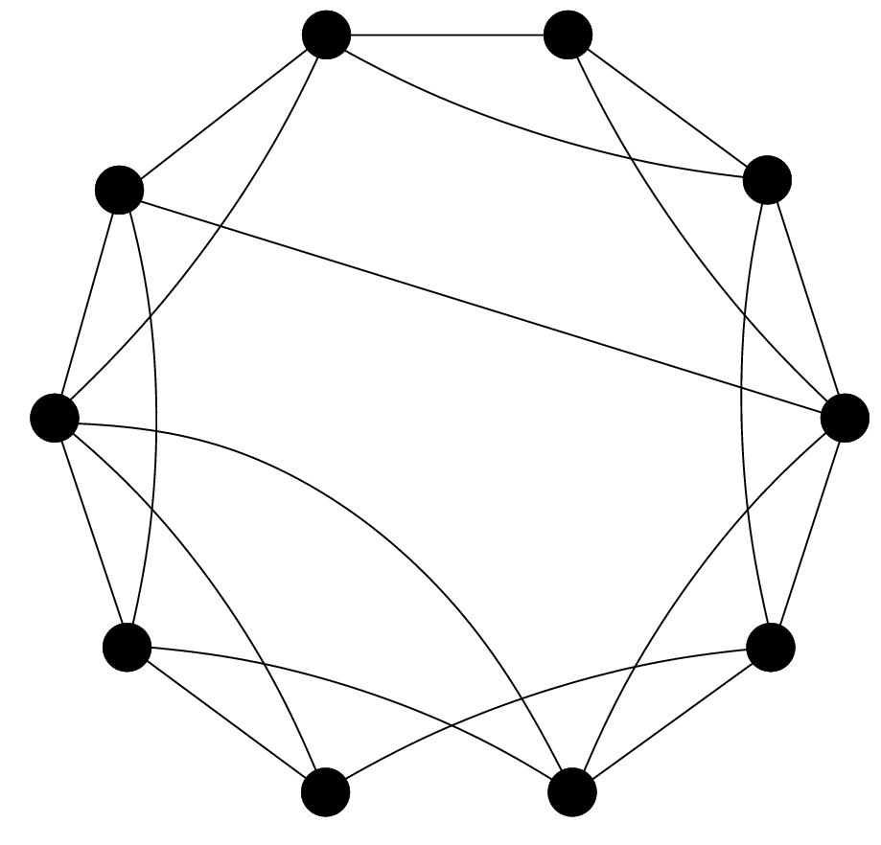
Lists
Tables
Graphs
First Item.
Second Item.
Third Item.

Slide 5
List
Start numbering at 0.
simple
Name
Items
0. Add the first item
1. Add an item
Indexes
2. Add another item.

Slide 6
Notation
ShoppingList
0. Milk
1. Eggs
2. Bread
>>> ShoppingList= [‘Milk', ‘Eggs', ‘Bread']
>>> ShoppingList
[‘Milk’, ‘Eggs’, ‘Bread’]
>>> ShoppingList[1]
‘Eggs'

Slide 7
Lists in Python
Items in lists can be
any type of objects
>>> ShoppingList= [‘Milk', ‘Eggs', ‘Bread']
Milk
Eggs
Bread
ShoppingList
index
0
1
2
Negative index
-3
-2
-1
>>> ShoppingList
[‘Milk’, ‘Eggs’, ‘Bread’]
>>> ShoppingList]1]
‘Eggs'
>>> ShoppingList[-2:-1]
[‘Eggs’]
>>> mixed = [‘Milk', 1.2, -10, ’other']
Items do not need to be all the same type

Slide 8
List operations
Operation | Description
len(a) | Length of list a
a + b | Concatenates list a and list b
n*a | Concatenates n copies of list a together
a[k] = x | Replace the item in a at position k with x
x in a | True if x is a item of a
x not in a | True if x is not a item of a
>>> a = [‘Milk', ‘Eggs', ‘Bread']
>>> len(a)
3
>>> a[1] = ’EGGS'
>>> a
[’Milk’, ’EGGS’, ’Bread’]
>>> new = 3*[1,2]
[1, 2, 1, 2, 1, 2]
>>> a + new
[’Milk’, ’Eggs’, ’Bread’, 1, 2, 1, 2, 1, 2]
Note: the list changes
Lists are mutable

Slide 9
In Python strings are the same as list of characters.
True
False

Slide 10
List methods
Operation | Description
a.append(x) | Append item x to list a
a.count(x) | Returns the number of times item x is in list a
a.index(x) | Returns first position item x is in list a
a.insert(k, x) | Insert item x at index k in list a
a.pop() | Return the last item in list a and remove it from the list
a.remove(x) | Removes the first occurrence of item x in list a
a.reverse() | Reverse all the items in list a
>>> a = [‘Milk', ‘Eggs', ‘Bread']
>>> a.reverse()
>>> a
[’Bread’, ’Eggs’, ’Milk’]
>>> a.pop()
’Milk’
>>> a
[’Bread’, ’Eggs’]

Slide 11
Suppose L = [2,5,1,2,5,3] and you go through the following instructions. The value of index is:
index = 5
j = 5
while j >= 0:
if L[j] < L[index]:
index = j
j = j - 1
5
2
1
0
None of the above

Slide 12
Age of the Kids
Two men meet on the street
A: All three of my sons celebrate their birthday today. Can you tell me how old each one is?
B: Yes, but you have to tell me something about them…
A: The product of their ages is 36.
B: I need more info…
A: The sum of their ages is equal to the number of windows in the building next to us…
B: I need more info…
A: My oldest son has blue eyes.
B: That is sufficient!
Notes:
12

Slide 13
The product of their ages is 36
Let y be the age of the youngest son.
Let m be the age of the middle son.
Let e be the age of the eldest son.
Assume y, m, and e are integers.
So

Slide 14
Generate all possible solutions
’Generate all possible solutions for Age of Kids'
for y in range(1, 37):
for m in range(y, 37):
for e in range(m, 37):
if y*m*e == 36:
print(str(y) + "," + str(m) + "," + str(e))
Notes:
Ask how they would find these triples. Get them to develop an algorithm with you in class.

Slide 15
solutions
0. 1, 1, 36
1. 1, 2, 18
2. 1, 3, 12
3. 1, 4, 9
4. 1, 6, 6
5. 2, 2, 9
6. 2, 3, 6
7. 3, 3, 4

Slide 16
Age of the Kids
Two men meet on the street
A: All three of my sons celebrate their birthday today. Can you tell me how old each one is?
B: Yes, but you have to tell me something about them…
A: The product of their ages is 36.
B: I need more info…
A: The sum of their ages is equal to the number of windows in the building next to us…
B: I need more info…
A: My oldest son has blue eyes.
B: That is sufficient!
Notes:
16

Slide 17
Generate all possible solutions
"""
Generate all possible solutions for Age of Kids
together with the sum of the ages.
""”
for y in range(1, 37):
for m in range(y, 37):
for e in range(m, 37):
if y*m*e == 36:
windows = y+m+e
print(str(y) + "," + str(m) + "," + str(e) +"," + str(windows))
Notes:
Ask how they would find these triples. Get them to develop an algorithm with you in class.

Slide 18
solutions
0. 1, 1, 36, 38
1. 1, 2, 18, 21
2. 1, 3, 12, 16
3. 1, 4, 9, 14
Sum of
their ages
4. 1, 6, 6, 13
5. 2, 2, 9, 13
6. 2, 3, 6, 11
7. 3, 3, 4, 10

Slide 19
Age of the Kids
Two men meet on the street
A: All three of my sons celebrate their birthday today. Can you tell me how old each one is?
B: Yes, but you have to tell me something about them…
A: The product of their ages is 36.
B: I need more info…
A: The sum of their ages is equal to the number of windows in the building next to us…
B: I need more info…
A: My oldest son has blue eyes.
B: That is sufficient!
Notes:
19

Slide 20
solutions
0. 1, 1, 36, 38
1. 1, 2, 18, 21
2. 1, 3, 12, 16
3. 1, 4, 9, 14
4. 1, 6, 6, 13
5. 2, 2, 9, 13
6. 2, 3, 6, 11
7. 3, 3, 4, 10

Slide 21
The main steps
Construct a list of possible solutions
For each possible solution, find the sum of the ages
Find those solutions which have the same sum of ages
Find out of those solutions which ones have an oldest son

Slide 22
Tables
Name of Table
Column numbers
Row numbers
ShoppingLists
0 1 2 3 4
0
1
2
3
Coles | Milk | Eggs | Coke
K-Mart | Shirt
Bakery | Bread | Cake
Fruit Shop | Apples | Bananas | Grapes | Oranges

Slide 23
Tables: List of Lists
ShoppingLists:
Coles | Milk | Eggs | Coke
K-Mart | Shirt
Bakery | Bread | Cake
Fruit Shop | Apples | Bananas | Grapes | Oranges
>>> ShoppingLists= [ [‘Coles’,’Milk’, ‘Eggs’, ‘Coke’], [‘K-Mart’,’Shirt’], [‘Bakery’, ‘Bread’, ‘Cake’], [‘Fruit Shop’, ‘Apples’, ‘Bananas’, ‘Grapes’, ‘Oranges’] ]

Slide 24
Given binomial = [[1], [1, 1], [1, 2, 1], [1, 3, 3, 1], [1, 4, 6, 4, 1]] what is the value of binomial[4]?
1
[1]
[1,3,3,1]
[1,4,6,4,1]

Slide 25
Given binomial = [[1], [1, 1], [1, 2, 1], [1, 3, 3, 1], [1, 4, 6, 4, 1]] what is the value of binomial[4][2]?
1
4
6
None of the above

Slide 26
Given binomial = [[1], [1, 1], [1, 2, 1], [1, 3, 3, 1], [1, 4, 6, 4, 1]] what is the value of binomial[0]?
1
[1]
[1,1]
None of the above

Slide 27
Given binomial = [[1], [1, 1], [1, 2, 1], [1, 3, 3, 1], [1, 4, 6, 4, 1]] what is the value of binomial[0][0]?
1
[1]
[2]
None of the above

Slide 28
Create list of possible solutions
"""
Create a list of all possible solutions for Age of Kids
together with the sum of the ages.
""”
solutions = []
for y in range(1, 37):
for m in range(y, 37):
for e in range(m, 37):
if y*m*e == 36:
windows = y+m+e
solutions.append([y,m,e,windows])
for item in solutions:
print(item)
Notes:
Ask how they would find these triples. Get them to develop an algorithm with you in class.

Slide 29
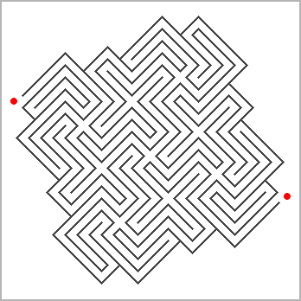
Creating Mazes
Develop a procedure for creating mazes.
Nine crossroads © Andrea Gilbert (www.clickmazes.com)

Slide 30
Simple Maze
Exit
Enter

Slide 31
Mark Junctions
 | ● |  | ● |  | ● |  | ● |  | ● |  | ● |  | ● | ●
 | ● |  | ● |  | ● |  | ● |  | ● |  | ● |  | ●
 | ● |  | ● |  | ● |  | ● |  | ● |  | ● |  | ●
 | ● |  | ● |  | ● |  | ● |  | ● |  | ● |  | ●
 | ● |  | ● |  | ● |  | ● |  | ● |  | ● |  | ●
 | ● |  | ● |  | ● |  | ● |  | ● |  | ● |  | ●
● | ● |  | ● |  | ● |  | ● |  | ● |  | ● |  | ●
Exit
Enter

Slide 32
Make passage ways
 | ● |  | ● |  | ● |  | ● |  | ● |  | ● |  | ● | ●
 | ● |  | ● |  | ● |  | ● |  | ● |  | ● |  | ●
 | ● |  | ● |  | ● |  | ● |  | ● |  | ● |  | ●
 | ● |  | ● |  | ● |  | ● |  | ● |  | ● |  | ●
 | ● |  | ● |  | ● |  | ● |  | ● |  | ● |  | ●
 | ● |  | ● |  | ● |  | ● |  | ● |  | ● |  | ●
● | ● |  | ● |  | ● |  | ● |  | ● |  | ● |  | ●
Exit
Enter

Slide 33
Representation of Maze
●
●
●
●
●
●
●
●
●
●
●
●
●
●
●
●
●
●
●
●
●
●
●
●
●
●
●
●
●
●
●
●
●
●
●
●
●
●
●
●
●
●
●
●
●
●
●
●
●
●
●
Notes:
Point out that this an example of a graph, and graphs are very useful for representing lots of concepts in computing.

Slide 34
Graphs
Vertex
Loop
Edge

Slide 35
Undirected/Directed

Slide 36
Non-simple/Simple

Slide 37
Disconnected/Connected

Slide 38
Unweighted/Weighted
2
10
16
24
2
0
3
4
5
12
1

Slide 39
Unlabelled/Labelled
C
B
A
E
T
W
X
P
Q

Slide 40
Trees
Graphs which are:
Simple,
Connected, and
Have no cycles.

Slide 41
Spanning Tree of a graph G

Slide 42
Spanning Tree of a graph G
Assume G is simple and connected.
A spanning tree of G is a tree which:
Contains all the vertices of G, and
The edges of the tree are edges of G.

Slide 43
Prim’s algorithm
Choose a vertex in the Graph
Add the edge to the Tree.
Put the vertex in the Tree
Is there a vertex not in the Tree?
Yes
Choose an edge between the Tree and this vertex
No
Return the tree
Notes:
Illustrate how this algorithm works.

Slide 44
Start with a Grid
●
●
●
●
●
●
●
●
●
●
●
●
●
●
●
●
●
●
●
●
●
●
●
●
●
●
●
●
●
●
●
●
●
●
●
●
●
●
●
●
●
●
●
●
●
●
●
●
●

Slide 45
Find the Spanning Tree
●
●
●
●
●
●
●
●
●
●
●
●
●
●
●
●
●
●
●
●
●
●
●
●
●
●
●
●
●
●
●
●
●
●
●
●
●
●
●
●
●
●
●
●
●
●
●
●
●

Slide 46
Find the Spanning Tree
●
●
●
●
●
●
●
●
●
●
●
●
●
●
●
●
●
●
●
●
●
●
●
●
●
●
●
●
●
●
●
●
●
●
●
●
●
●
●
●
●
●
●
●
●
●
●
●
●

Slide 47
Add entrance and exit
●
●
●
●
●
●
●
Exit
●
●
●
●
●
●
●
●
●
●
●
●
●
●
●
●
●
●
●
●
●
●
●
●
●
●
●
●
●
●
●
●
●
●
●
●
Enter
●
●
●
●
●
●
●
●

Slide 48
Put in walls
 | ● |  | ● |  | ● |  | ● |  | ● |  | ● |  | ● | ●
 | ● |  | ● |  | ● |  | ● |  | ● |  | ● |  | ●
 | ● |  | ● |  | ● |  | ● |  | ● |  | ● |  | ●
 | ● |  | ● |  | ● |  | ● |  | ● |  | ● |  | ●
 | ● |  | ● |  | ● |  | ● |  | ● |  | ● |  | ●
 | ● |  | ● |  | ● |  | ● |  | ● |  | ● |  | ●
● | ● |  | ● |  | ● |  | ● |  | ● |  | ● |  | ●
Exit
Enter

Slide 49
Remove Tree
Exit
Enter
Notes:
Point out that is only one approach for creating a maze and could be easy modified to include loops. Ask them to think about what properties they would like their mazes to have, and get them to think about how they would write an algorithm so that they could create mazes with those properties.

Slide 50

Fake Coin
Suppose your friend has twelve coins which all appear identical. However one of the coins is a fake. This fake coin has a different weight than the other coins but, you have not been told whether it is heavier or lighter. You have been asked to identify the fake coin on a balance scale, not using weights, in as few as possible weighings.
Scales from the Law Offices of Gallagher & Sproviero -(www.flickr.com/photos/vaxzine/485424742/)
Notes:
50

